Slide 1
BK Tree
By Endriu Abazi

Slide 2
Content
Introduction to BK tree
Triangular Inequality
Levenshtein Distance
Constructing a BK tree
Implementation in JS
Real life usage
Conclusion

Slide 3
Introduction to BK tree
BK Trees are data structures that are used to perform spell checking. They were first proposed by Burkhard and Keller in 1973. This algorithm uses two very basic concepts to improve the time complexity of various string matching operations.These concepts are:
Triangular Inequality
Levenshtein Distance

Slide 4
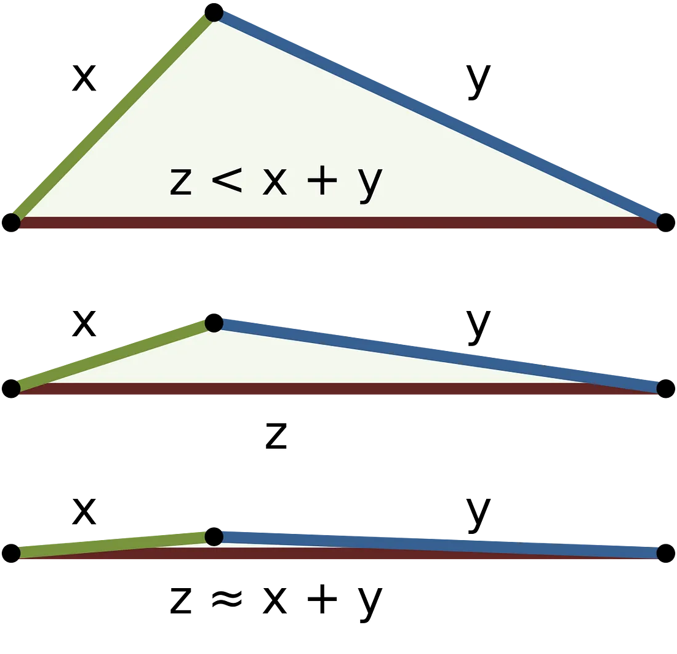
Triangular Inequality
This is a very simple mathematical concept which states that:
The sum of any two sides of a triangle is always greater than the third side.

Slide 5
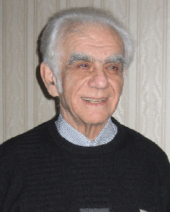
Levenshtein Distance 1/2
The Levenshtein Distance, also known as the Edit Distance, is a measure of the difference between two sequences of characters. It’s named after the Russian scientist Vladimir Levenshtein, who originally considered this distance in 1965.

Slide 6
Levenshtein Distance 2/2
The Levenshtein Distance between two strings is defined as the minimum number of operations needed to transform one string into the other, with the allowable operations being insertion, deletion, or substitution of a single character.

Slide 7
Explanation
Insertion: If we have the word “hat” and we want to change it to “chat”, we would insert the letter “c” at the beginning. This is one operation.
Deletion: If we have the word “chat” and we want to change it to “cat”, we would delete the letter “h”. This is also one operation.
Substitution: If we have the word “cat” and we want to change it to “car”, we would substitute the letter “t” with the letter “r”. Again, this is one operation.

Slide 8
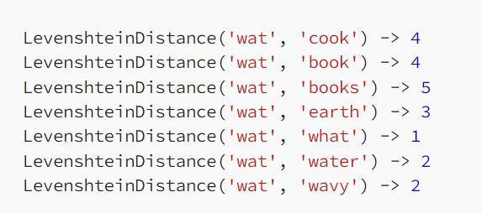
Example
For instance, if we wanted to know out of the set of words [cook, book, books, earth, what, water, wavy] which word the misspelling “wat” is closest to, we could do a full scan of the list and find the words with the lowest Levenshtein distance:

Slide 9
Constructing a BK tree
Let’s build one together using the same simple dictionary we looked at earlier: [cook, book, books, earth, what, water, wavy].
We will use “cook” as the root node and add the words as they appear in the list

Slide 10
Construction Rule
Choose a root word: The first word in your list becomes the root of the tree.
For each remaining word in the list:
Start at the root and calculate the Levenshtein distance between the word you’re inserting and the word at the current node.
If a child node already exists at the calculated distance, move to that child node and repeat the process.
If no child node exists at the calculated distance, create a new node with the word you’re inserting and add it as a child node at the calculated distance.
Repeat step 2 until all words have been inserted into the tree.

Slide 11
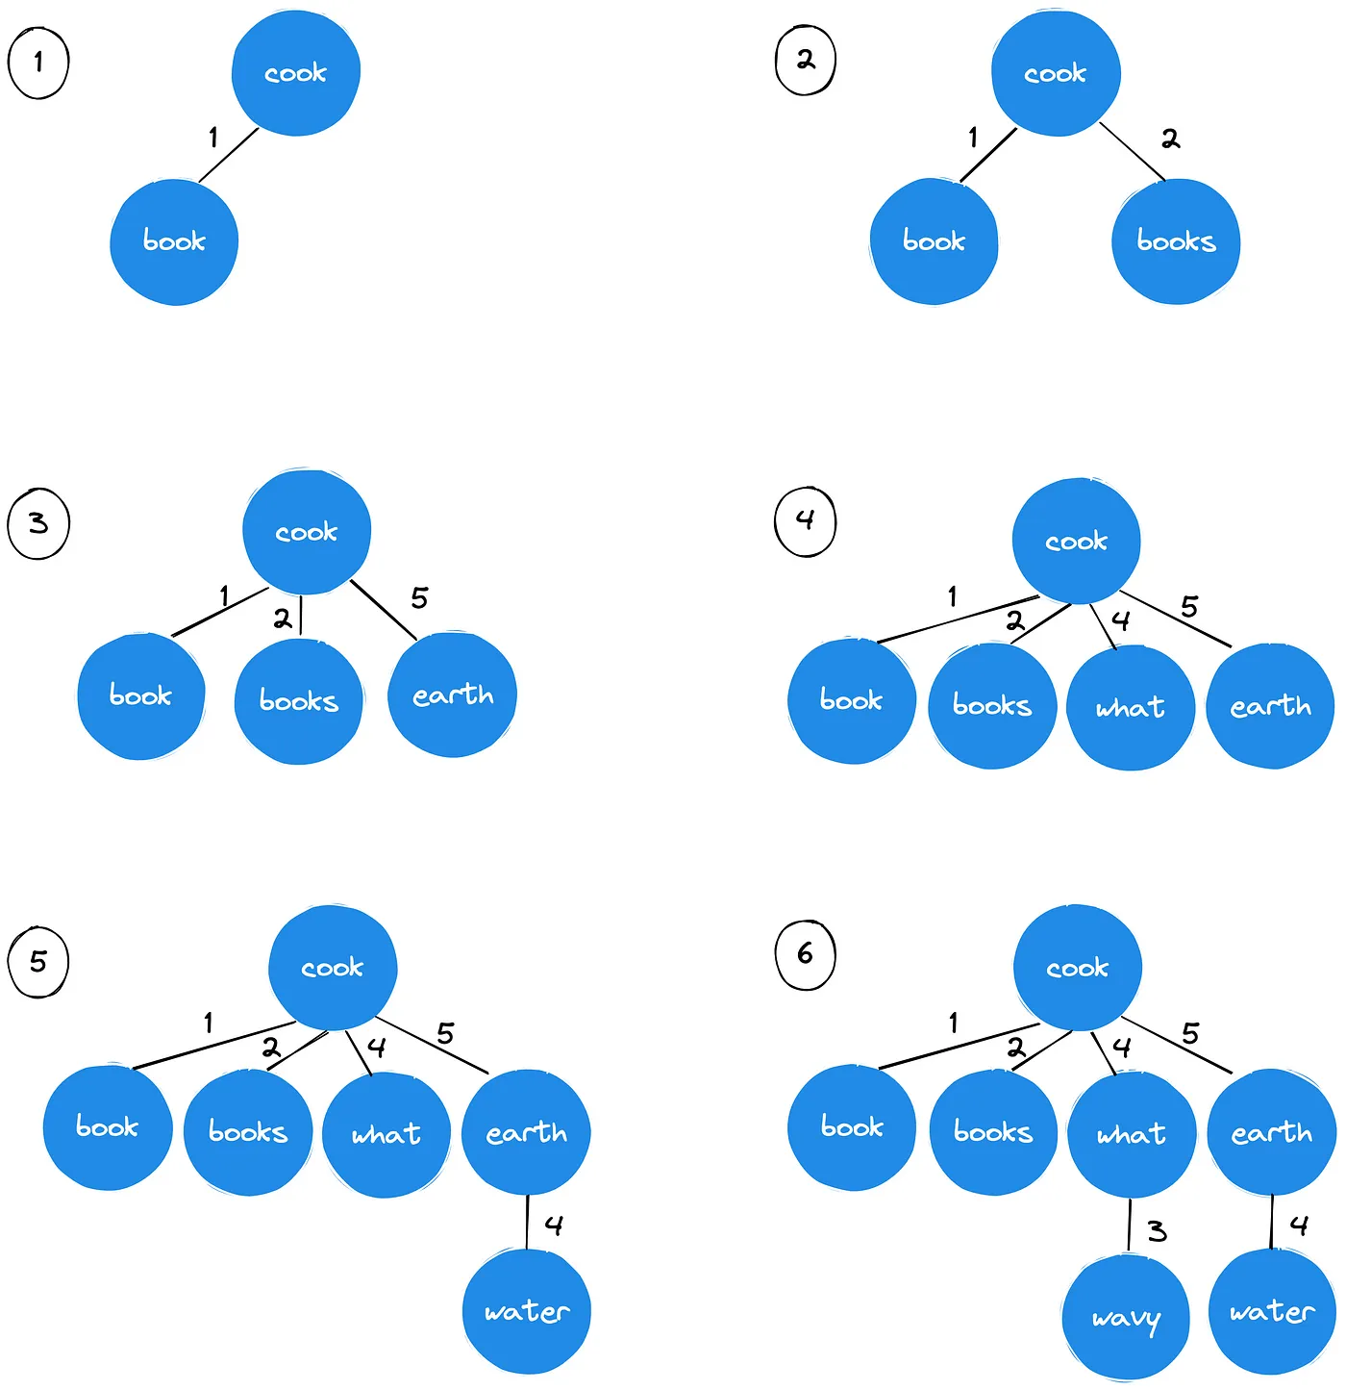
Result
Now that we have our structure, how do we search it? This is actually simpler than you may think. We need to take our misspelled word “wat” and find matches within a certain level of tolerance, which we’ll call N. We do this by taking the Levenshtein Distance of our word and compare it to the root, and then explore all nodes that are that distance +/- N.

Slide 12
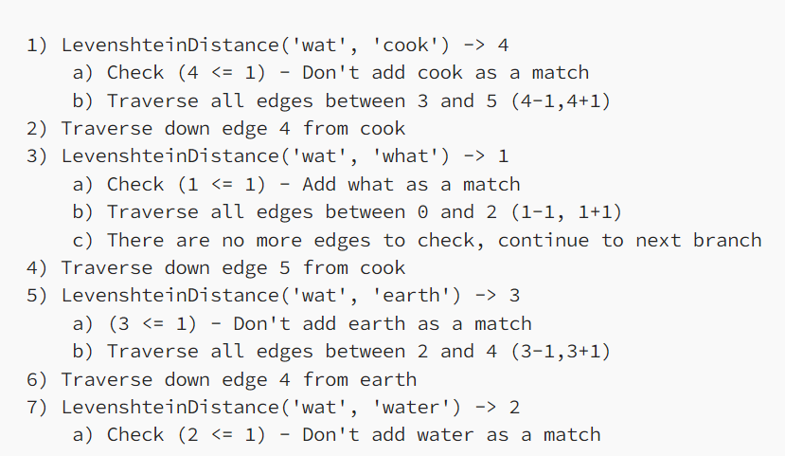
Algorithm
Let’s use our BK tree to search for the closest match to the misspelling “wat” within the tolerance of 1. The tree traversal would look like this:

Slide 13
Why Does This Matter?
Traversing our BK tree to find potential matches is an approximately O(log(n)) time operation which is significantly better than our O(n) time that we had before by searching each word in our dictionary. However, it is important to note that our tolerance (N) can drastically increase the number of nodes we need to visit, so it is important to pick an appropriate N.

Slide 14
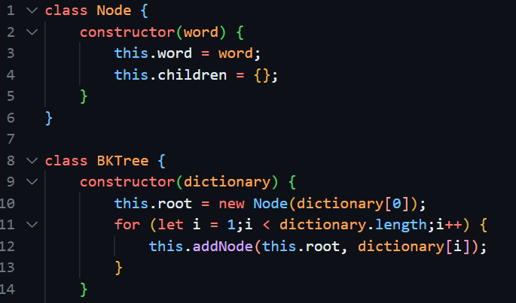
Implementation in JS

Slide 15
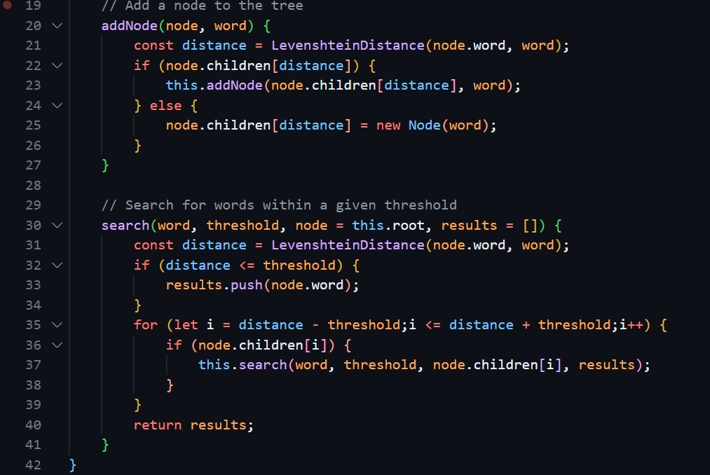

Slide 16
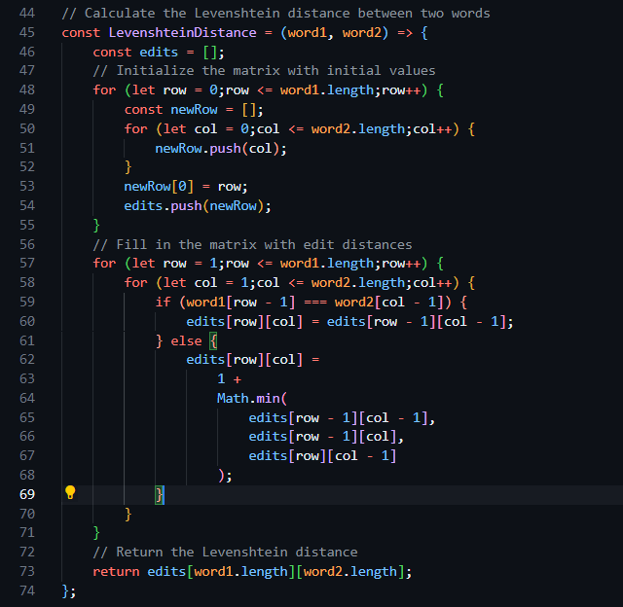

Slide 17
Real life usage
Spell Checking: BK trees are often used in spell check systems1. When you type a word, the system can use a BK tree to find words in its dictionary that are close to the typed word in terms of their Levenshtein distance. This allows the system to suggest corrections for misspelled words.
Auto-Correct Features: Various autocorrect features in many software applications can be implemented based on BK trees. For instance, if you type a word incorrectly on your phone, the autocorrect feature can use a BK tree to suggest the correct word.

Slide 18
Conclusion
So next time you misspell a word and see that red underlining, just know that Levenshtein and BK are hard at work!

Slide 19
Thank you !

